Slide 1
Anaconda 4.2 Installation on Windows 7 64 bit machine
Errors and Notes from 3rd installation attempt:
Use case: Default of Python 2.7 but with 3.6 and R environments, Spyder as Python 2.7, and Rstudio in support of upcoming classes
Started: 1/4/2016
Issues Posted on Github (current ones):
Rstudio Installation failure → https://github.com/ContinuumIO/anaconda-issues/issues/1337
Issue of bad icon generation → https://github.com/conda/conda/issues/4171
Unit test (issues w/ 4.2) → https://github.com/ContinuumIO/anaconda-issues/issues/1352
Version 2b-2: not posted: edited some slides through-out and added a few to end of first section
Version 2c: added slides to end, just before the section break (slides 32 up until section break)

Slide 2
About these slides
Each problem is presented with some of the things tried along the way towards fixing an issue or at least identifying what was wrong to report it
Solutions/work-arounds found are also presented (usually at the end of a section)
Red Bold comments are intended for Continuum / Anaconda personnel to evaluate ideas about how to fix Anaconda in future patches or distributions to help users avoid my pain. ☺

Slide 3
Problems encountered building an R env
Why I tried Jupyter for R instead of Navigator?
Navigator is using Python 3.4 and 3.5 for python environments
Jupyter, by default, creates a Python 3 environment that is Python 3.6
Which one has higher version for R (if either)?
Don’t know – so started with Jupyter
Note too: Navigator does not show the user what version installed packages are. Jupyter does. But user can switch between them and use Navigator when it is desirable to do so.
As shown in these slides – Jupyter failed in multiple attempts to create an R environment and I then tried Navigator
One variable I did not test for: R env was named R_Main or R_Live in my Jupyter tests while I simply named it R in my Navigator tests

Slide 4
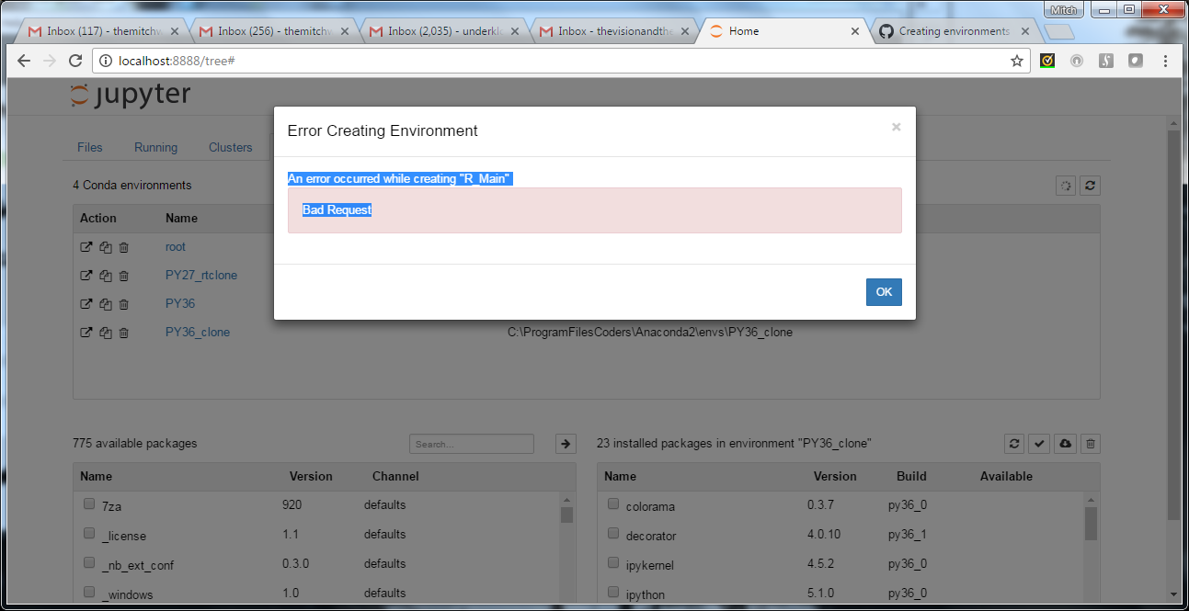

Slide 5
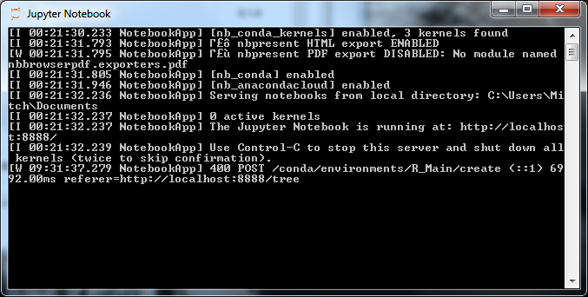
Jupyter Notebook command window during this error:

Slide 6
Notes on error creating R Env
Shut down all Anaconda apps (and closed all)
Re-opened Jupyter and Anaconda Prompt
Tried to create R_Main on Jupyter using [+] on conda tab a second time and got exact same error
Last time – it errored out quickly; this time, the icon on the page that shows it is working on something continued to spin for long while after clicking OK on the error
Shut down Jupyter console and yet on the web page the icon continued to spin (see next slide)
Closed web page to ensure it is not still sending commands

Slide 7
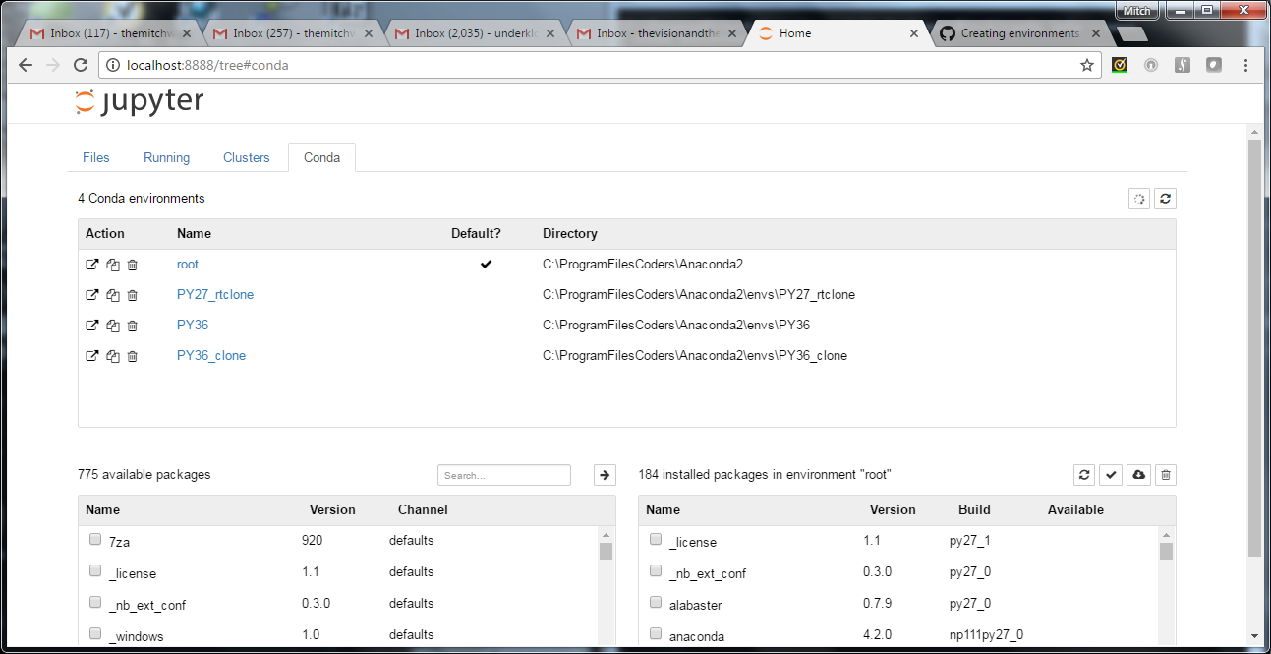

Slide 8
Third attempt
First two done on Chrome with environment name of “R_Main”
Third attempt uses “R_Live” for env name and does it on IE
Got same error
Fourth attempt made using Navigator instead
Error follows on next slide – but environment seemed to build okay
This happened same way in tests on previous environment that I later blew away and started over due to other problems (so problem seems reproduce-able at least on a Win7 64 bit machine) – see next slide

Slide 9
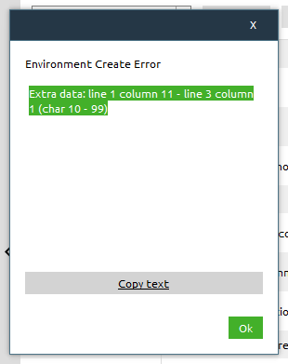
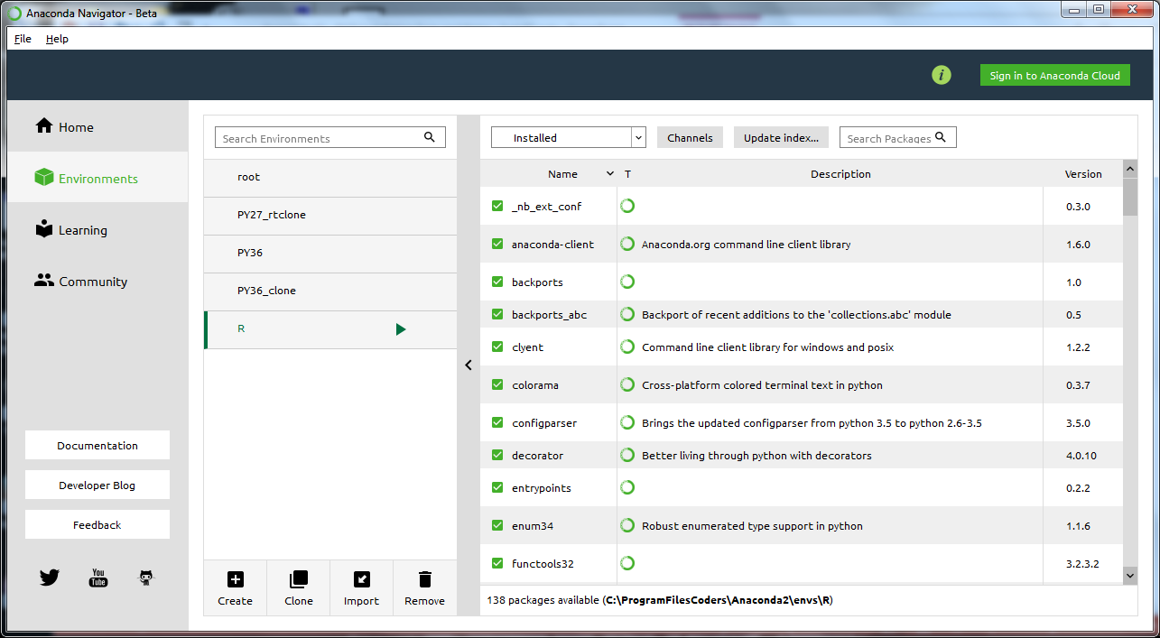
This error occurred both in creating the R environment, and later when cloning the R env to R_clone. But after clicking “OK” env seemed to complete and “Hello World” worked in a test notebook

Slide 10
Test code was obtained from the web for the R environments
A notebook with R code found on the web failed to run until “update conda –all” was run on the R environment
Confusing to a novice user: after this update – two versions of the environment appear in the Jupyter menus.
The one that starts with “Python” loads with a python icon in the corner and some of the code breaks when running it.
The one that starts with “R” loads with an R icon in the corner and all of the code runs fine …
Code used for this test: http://r4stats.com/examples/programming/

Slide 11
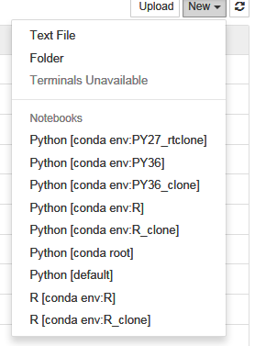
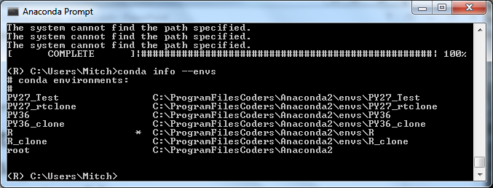
Test code was obtained from the web for the R environments – page 2
Screenshots illustrating previous slide
Note: in menu: 4 “R” menu kernels created, but only 2 R environments were deployed and show in “conda info –envs”. “conda list” shows that “update conda –all” added some Python 2.7 libraries as well as R to each env and I think it was then that the second working menu item appeared only after update.

Slide 12
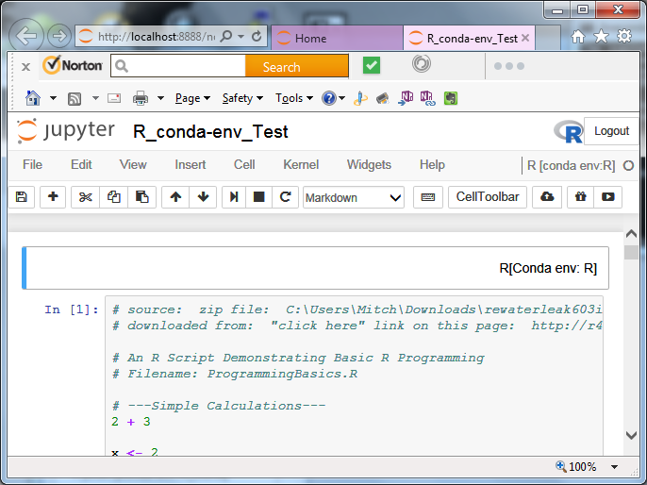
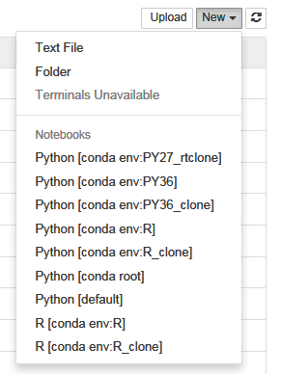
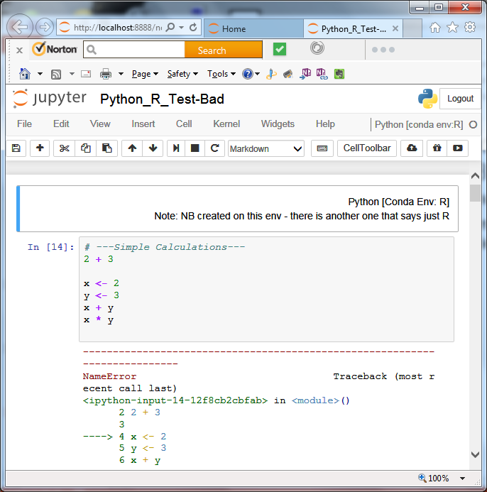
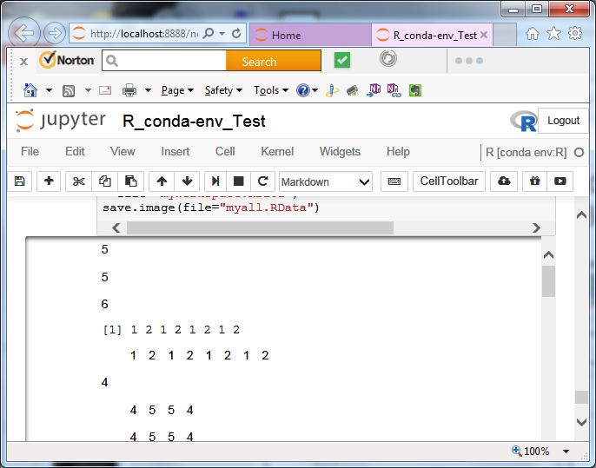
Test code was obtained from the web for the R environments – page 3
Screenshots illustrating previous slide
Same notebook code works under one menu kernel and fails under the other (even though they tie to same environment:

Slide 13
More info in case it helps …
For R environments: After creating the environment and running “conda update –all” on it, packages were all up-to-date. Literally the next day, a dry-run of the same command revealed packages that now could be updated. Not sure if this is normal or not (ie. Did it miss this package with update –all, or was it literally updated again?)
The following scripts and their output are provided in case knowing the full env setup of this installation help with looking into any slides in this deck.
Note: see later slide on Anaconda prompt batch file issues (near end of deck) if you are having any problems editing and running these scripts yourself (tested under Win7 64bit only)

Slide 14
Jupyter menu issues from installations
Default installation: produced two menus: Python [default], and Python [root] – this is confusing for a new user and does not have the name of what version you are working in for the environment.
R environments – produce two menu items each as described earlier, but only the ones starting with “R” (which I think got generated after running “conda update –all” on each R environment) seem capable of running even basic R code. Simple math operations fail in the version of the menu kernels with “Python” in the name.
An attempt was made on Navigator to create a PY27_test” environment after the clone of root proved useless. This environment built with only 5 packages in it and did not generate a menu item to make it possible to use it.

Slide 15
Test Env – Update Problem – pg 1
Point of test environment setup is to sanity check planned actions before messing up a live environment.
This env was created by cloning root from navigator – after cloning – we cannot use it this way
I think a workaround solution has been found to this … which appears on the last slide in this section, but solution indicates Anaconda 4.2 needs to be fixed
(PY27_rtclone) C:\Users\Mitch>conda info --envs
# conda environments:
#
PY27_rtclone * C:\ProgramFilesCoders\Anaconda2\envs\PY27_rtclone
PY36 C:\ProgramFilesCoders\Anaconda2\envs\PY36
PY36_clone C:\ProgramFilesCoders\Anaconda2\envs\PY36_clone
R C:\ProgramFilesCoders\Anaconda2\envs\R
R_clone C:\ProgramFilesCoders\Anaconda2\envs\R_clone
root C:\ProgramFilesCoders\Anaconda2
(PY27_rtclone) C:\Users\Mitch>conda update --all
Fetching package metadata ...........
InstallError: Install error: Error: 'conda' can only be installed into the root
environment
(root) C:\Users\Mitch>conda info --envs
# conda environments:
#
PY27_rtclone C:\ProgramFilesCoders\Anaconda2\envs\PY27_rtclone
PY36 C:\ProgramFilesCoders\Anaconda2\envs\PY36
PY36_clone C:\ProgramFilesCoders\Anaconda2\envs\PY36_clone
R C:\ProgramFilesCoders\Anaconda2\envs\R
R_clone C:\ProgramFilesCoders\Anaconda2\envs\R_clone
root * C:\ProgramFilesCoders\Anaconda2
(root) C:\Users\Mitch>conda update -n PY27_rtclone --all --dry-run
Fetching package metadata ...........
InstallError: Install error: Error: 'conda' can only be installed into the root
environment

Slide 16
Test Env – Update Problem – pg 2
Test of updating Spyder or beautifulsoupt only on clone of root – also fails
Note that clone was created with Navigator which did not copy two packages but appears to have left in packages that cause these issues with “update”:
(PY27_rtclone) C:\Users\Mitch>conda update beautifulsoup4
Fetching package metadata ...........
Solving package specifications: ..........
InstallError: Install error: Error: one or more of the packages already installe
d depend on 'conda'
and should only be installed in the root environment: conda-env
These packages need to be removed before conda can proceed.
(PY27_rtclone) C:\Users\Mitch>conda update spyder
Fetching package metadata ...........
Solving package specifications: ..........
InstallError: Install error: Error: one or more of the packages already installe
d depend on 'conda'
and should only be installed in the root environment: conda-env
These packages need to be removed before conda can proceed.

Slide 17
Test Env – Update Problem – pg 3 Fix for problem
It took a lot of testing to figure this out, but in Jupyter, on the conda tab, after cloning an environment, it looks like just one package: conda-env needs to be deleted.
Deleted this package and conda update commands started working again and I was able to test installations again
Navigator should really be fixed so that during cloning it does not leave in “conda” or any “conda-” packages
Multiple tests confirm that it misses “conda-env” when it removes all the “conda / conda-” packages during cloning.

Slide 18
Navigator env build failure: Attempt to create PY27_test environment
Anaconda Navigator attempt: used create to build new env.
This only produced 5 packages
This did not add the environment to the menus in Jupyter
No errors – just ended with very tiny environment
Wondering if this happened because 2 PY27 environments exist already:
Root
Root_clone (which isn’t working right – can’t update it)
Deleted after creation since it did not work
Then attempted to re-create the env using Jupyter → conda tab [+]
It works there: builds environment with 30 packages and a menu kernel on Jupyter
Note: menu did not appear at first but closing the browser window and reloading it seemed to work
Odd symptom: on my machine Jupyter loads in IE, if I tried to open a new session in Chrome, it asked for a password, but if I re-opened IE and typed the URL, then I got the desired result
Normally, can copy and paste the URL form IE to Chrome to work there after Jupyter first loads. During earlier installation, after beautifulsoup package got corrupted during an install, this symptom occurred pervasively forcing me to use Chrome only during debugging until I realized I needed to rebuild the environment
Conda team could replicate environments and see if same error occurs for them

Slide 19
The icon problem
With the creation of new environments, execution of commands to add environments to the Jupyter menus, and even, execution of “conda update –all”, new icons get build for all Anaconda applications.
When system builds these icons for R environments – clicking the icon to Anaconda Prompt for example, crashes
Other icons, when they work, do not appear to do anything different than the original icons, but this may be an illusion – there is no indication on an open app that it is somehow running on the otherenvironment
In my final environment – I moved all extra icons into a folder just in case they would be needed for anything (may delete them later)
The results of this replication effect in my start menu icons is shown on the next slide

Slide 20
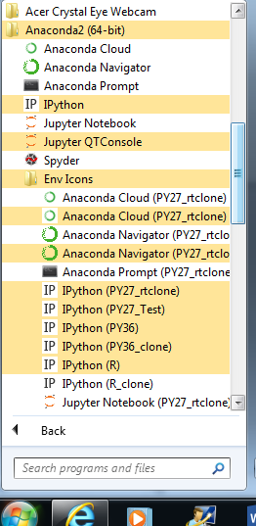
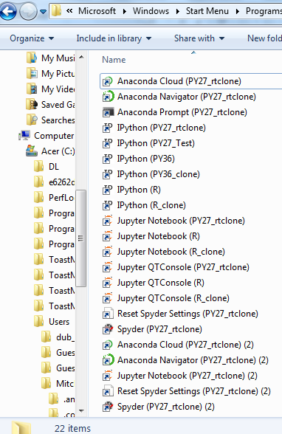
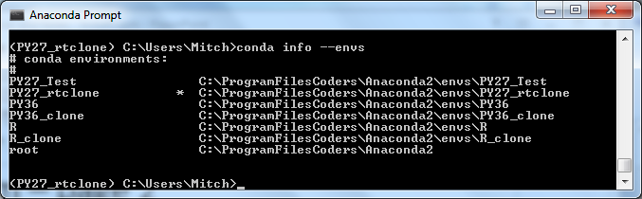
The icon problem – page 2
Start menu: full view of folder in start (icons moved here)
env list for compare
More documentation of this issue was posted
On github at this location:
https://github.com/conda/conda/issues/4171

Slide 21
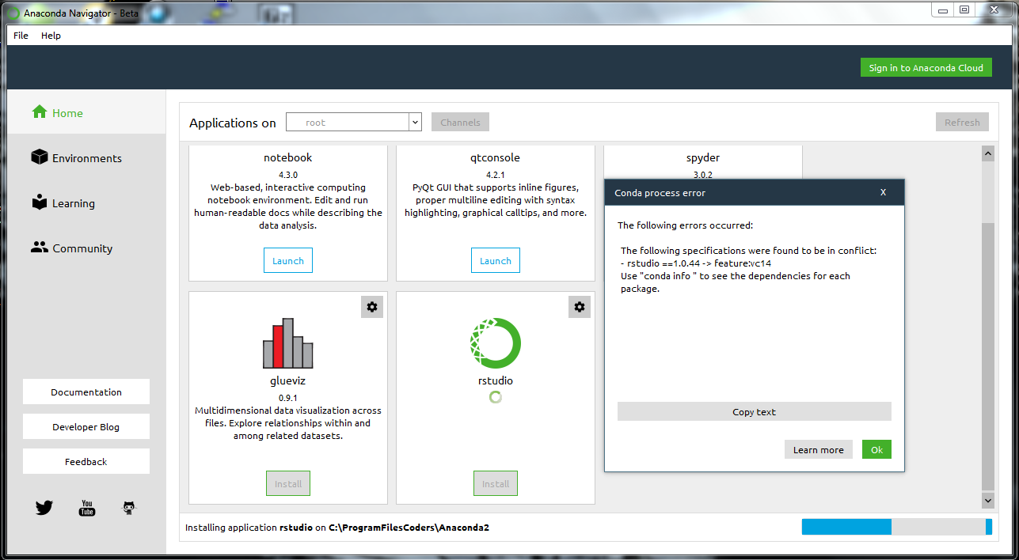
R Studio Installation Problem
The following specifications were found to be in conflict: - rstudio ==1.0.44 -> feature:vc14 Use "conda info " to see the dependencies for each package.

Slide 22
R Studio Installation Problem – p2
license : Commercial or AGPLv3
license_family: GPL
machine : x86_64
md5 : 0fafc9ba23a5ad2e70efa47eb5ebdcca
operatingsystem: win32
platform : win
priority : 0
schannel : r
subdir : win-64
summary : A set of integrated tools designed to help you be more productive
with R
target-triplet: x86_64-any-win32
type : app
url : https://conda.anaconda.org/r/win-64/rstudio-1.0.44-vc14_1.tar.bz2
dependencies:
m2-openssh
m2w64-diffutils
m2w64-grep
qt >=5.6
r-essentials
vs2015_runtime
(C:\ProgramFilesCoders\Anaconda2) C:\Users\Mitch>conda info rstudio
Fetching package metadata ...........
rstudio 1.0.44 vc14_1
---------------------
file name : r::rstudio-1.0.44-vc14_1.tar.bz2
name : rstudio
version : 1.0.44
build number: 1
build string: vc14_1
channel : r
size : 67.4 MB
app_entry : ${PREFIX}/Library/bin/rstudio.exe
app_type : desk
arch : x86_64
binstar : {u'package_id': u'58335c5dda6c9911120d1fb1', u'channel': u'main',
u'owner_id': u'52c5dc11f53f2a0b1a9de428'}
features : vc14
fn : rstudio-1.0.44-vc14_1.tar.bz2
has_prefix : True
icon : c839dc03e5d17d3cd61dbf23ae3ca88b.png

Slide 23
R Studio Installation Problem – p3
Conda list for my root environment: has qt 5.6.x so this is fine
It also has vs2008_runtime
Previous slide shows that Rstudio uses vs2015_runtime
Can both components be installed on same environment?
Don’t know / unsure how to proceed
Another issue: Rstudio does not ask for an environment to install to. If it wants root – does this mess up my Python 2.7 in the root?
If not root – do I install it to an R Environment and if so – how to launch it?
Intial thoughts on alternatives:
log the issue on github
Continue investigation with stack overflow and other soures
consider if I can do stand-alone installation outside of Anaconda if all else fails

Slide 24
Rstudio Installation Problem – p4
Links online:
Link from debugging a mac (not sure if this can help with win-64):
https://support.rstudio.com/hc/en-us/community/posts/207830688-Using-RStudio-with-conda
To install Rstudio by itself (not w/ Anaconda)
R language: https://cran.rstudio.com/
Rstudio: https://www.rstudio.com/products/rstudio/download3/
This might be more useful – see comments later in the thread – early ideas get contradicted and corrected:
https://github.com/ContinuumIO/anaconda-issues/issues/777
Note: this talks about how great it would be to add Rstudio to Navigator – which was done, but now that doesn’t work, so more work is indicated to resolve this by Anaconda; in interim … these links may help …
Just in case: Missing dll problem in an Rstudio install: https://support.rstudio.com/hc/en-us/community/posts/210805097-RStudio-doesn-t-start-libbz2-1-dll-is-missing

Slide 25
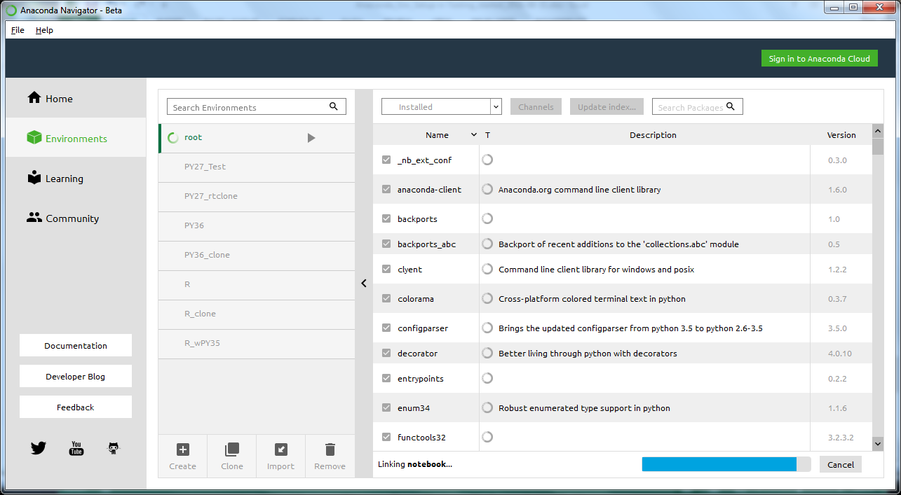
Rstudio Installation Problem – p5
These issues were posted to document the Rstudio problem (2nd one started by request of Anaconda):
https://github.com/conda/conda/issues/4204
https://github.com/ContinuumIO/anaconda-issues/issues/1337
Attempt to build R_w_PY35 3nvironment (checking R and Python 3.5 to create) for some reason jumped up to root and hung up while message show linking to many packages

Slide 26
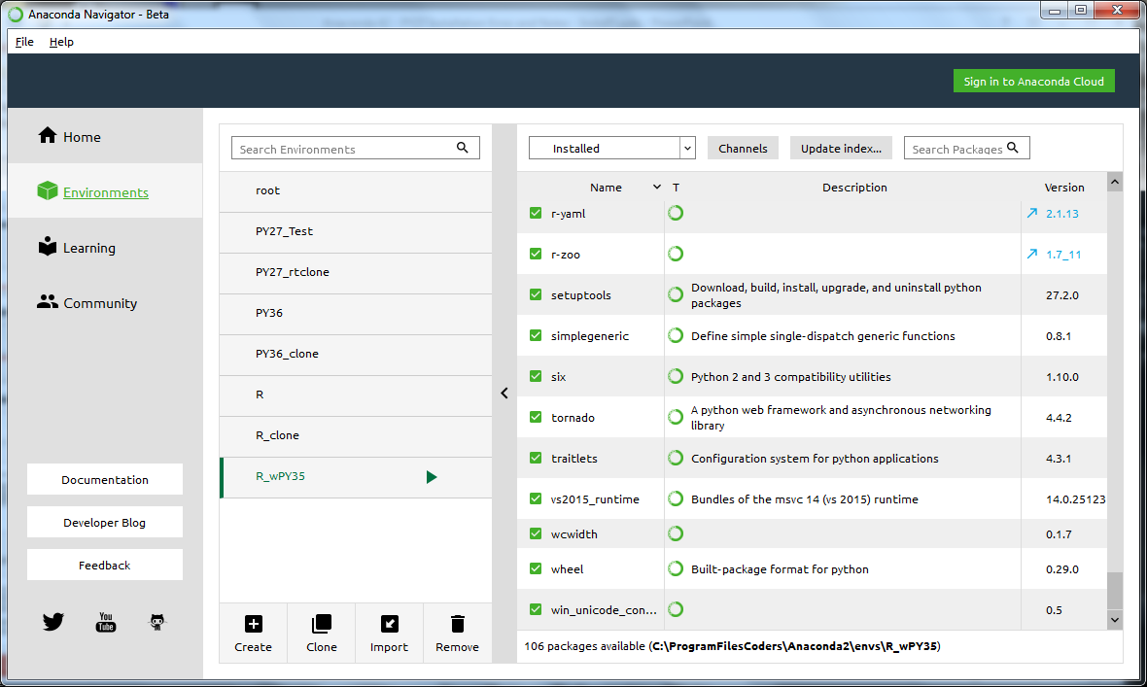
Rstudio Installation Problem – p6
2nd failure of clicking Rstudio installation button
Before clicking it on Navigator (shown on next slide), selected this environment as per discussion thread on open github issue
https://github.com/ContinuumIO/anaconda-issues/issues/1337

Slide 27
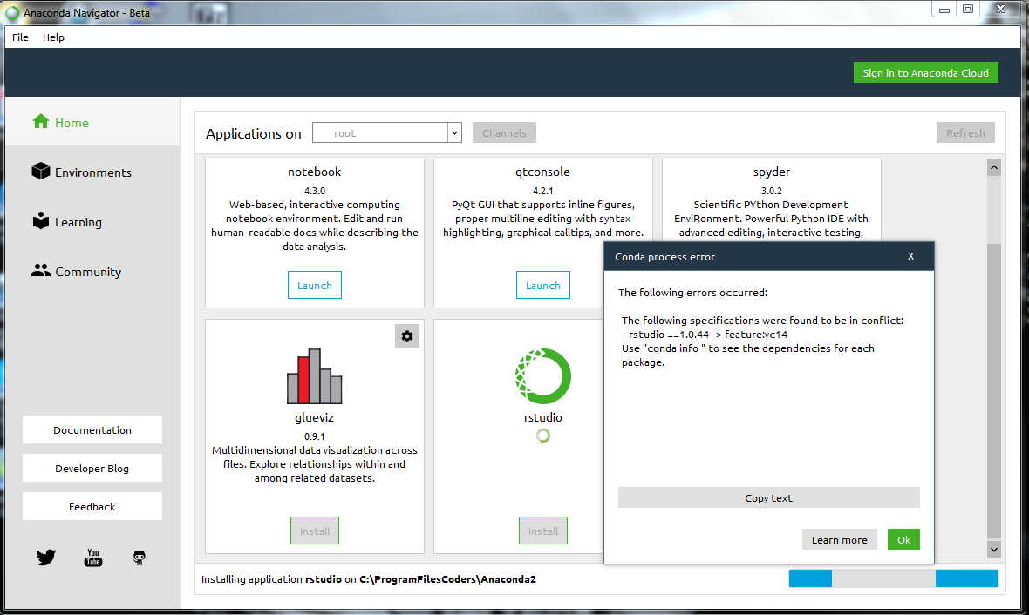
Rstudio Installation Problem – p5
2nd failure of clicking Rstudio installation button
Did this with only Anaconda Navigator open and had selected R/PY35 env shown in previous slide
Turns out – this was not what was intended in instructions on the open issue
Attempt 3 on next slide

Slide 28
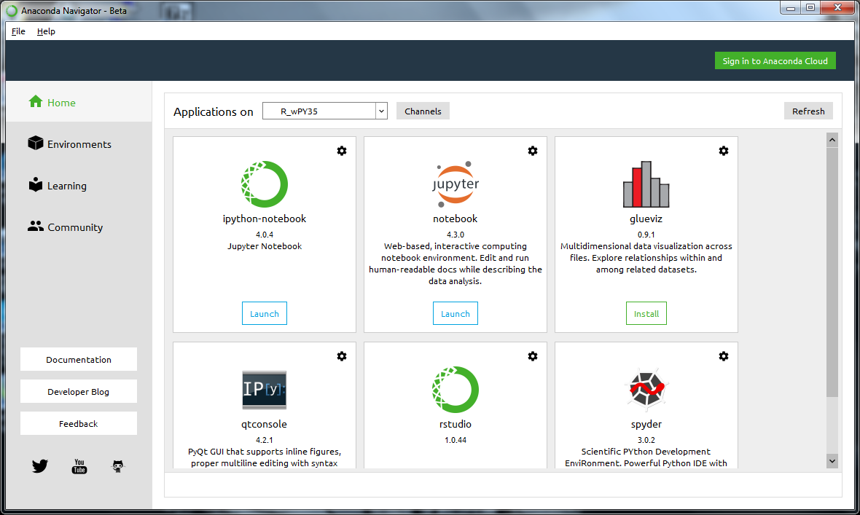
Rstudio Installation Problem – p5
Select env

Slide 29
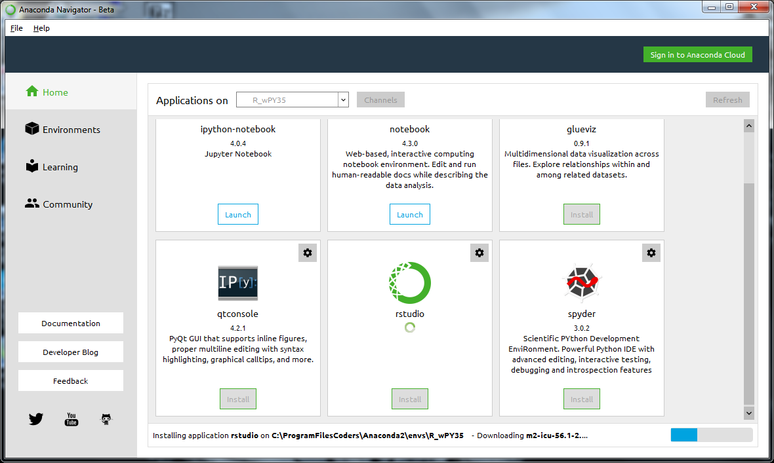
Rstudio Installation Problem – p5
Early part of install process

Slide 30
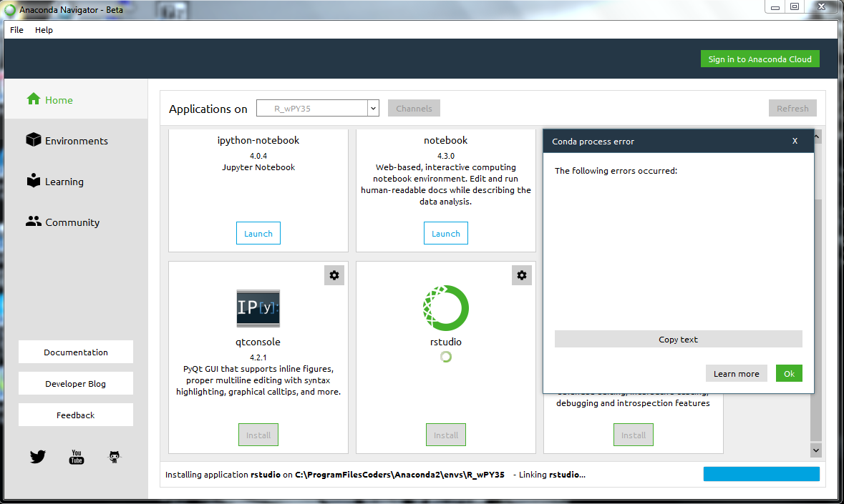
Rstudio Installation Problem – p5
3rd Attempt Fails

Slide 31
Issues and limitations of the finished env
Shortly after installation of all environments was complete (but before I followed instructions to build an R/Python 3.5 env), I thought that I experienced crashes if attempting to load a Notebook from an R environment in one browser tab and one from a Python environment in another. This problem, if it occurred on the “good kernels” has not been replicated since.
However: There is an issue that 2 kernels are generated for R as shown in screenshots elsewhere in this document (and at left). If you open the notebook where the environment says “Python [conda env: R …” – you get the crashing symptom and R does not work well in it anyway. Much of the code syntax behaves as if it is invalid. Originally, it looked like “R[conda env: R…] worked, but -
Further testing reveals that even in these environments, R works more but there are still parts of it that don’t function.
The best working environment seems to be the one I built with checkboxes for Python 3.5 and R only (not shown at left). That one was built as part of preparations to install Rstudio, and it seems to be the only working R environment that does not throw errors from common code. However, see next slide for an odd symptom there

Slide 32
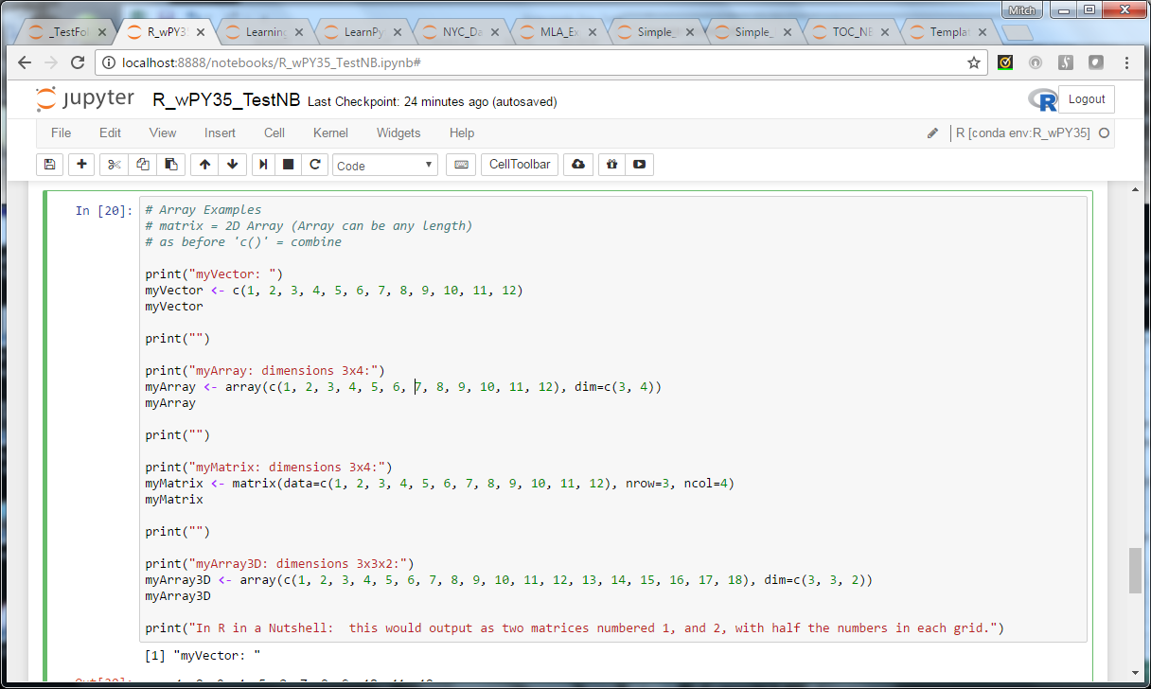
R w Python 3.5 – has display limitation
Multi-dimensional arrays do not output correctly if they are more than 2 dimensions. Only 2-D Arrays and matrices do. I discovered this while testing code from “R in a Nutshell” and comparing my output to what was in the book (probably taken from Rstudio).
Input on this slide
Output on next slide

Slide 33
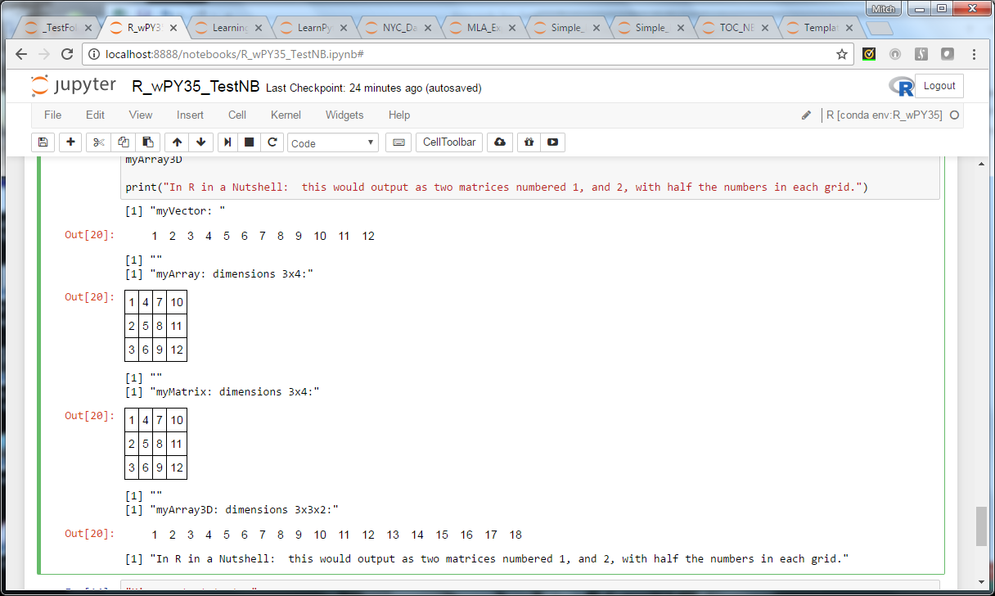
R w Python 3.5 – has display limitation
Multi-dimensional arrays do not output correctly if they are more than 2 dimensions. Only 2-D Arrays and matrices do. I discovered this while testing code from “R in a Nutshell” and comparing my output to what was in the book (probably taken from Rstudio).
Input on prev slide
Output on this slide

Slide 34
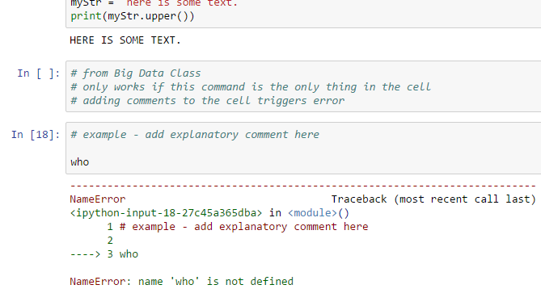
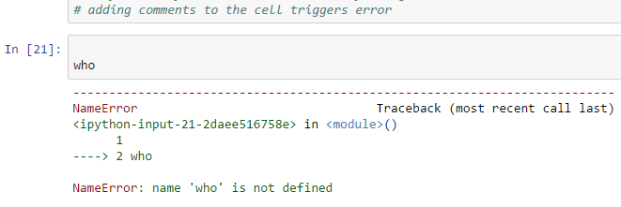
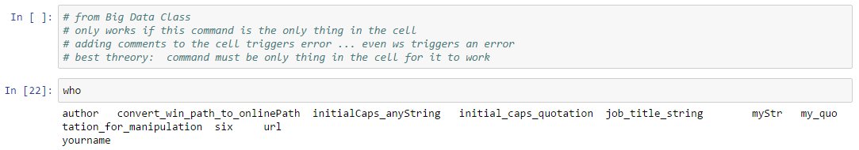
The who command …
Command I learned in my online class: “Big Data and Social Analytics”
Not sure if this is a python command or an iPython command only
Tested in Python 2.7 and 3.5
But for some reason, though it worked even with comments intermittently in the cell in our class environment which was on an Ubuntu/Linux instance on AWS, on Windows, it consistently fails if you put the comment in the same cell as the code.
Tests to document this reveal that on windows, if you put anything in the cell (even whitespace) along with the “who” command, it fails.
Make it the only thing in the cell and you get your list of variables in use in the notebook as expected.

Slide 35
Errors and Notes from first two installs
Before they were cleaned off my system

Slide 36
Other errors encountered along the way
It took at least 3 installations that were later de-installed, the PC scrubbed of potential config files, and then environment started fresh before a clean installation was achieved with all desired environments
Due to these issues – a decision was made to create test environments of each desired env. to check if installations would work ahead of trying them again
Slides before this point: issues with my final good installation and what I did to fix them or at least work around them
Slides after this point: in no particular order, issues encountered on earlier installations before I blew away and replaced those installations

Slide 37
An attempt to fix “Spyder” problem that killed my environment
I attempted to run “conda update –all” to fix broken Spyder before knowing about what is on the next slide. This literally killed my environment: Anaconda Prompt stopped working and with that broken I did not test further to see what else was broken, I just started over.
The error, however, and thread from my post on github indicates that Windows 7 handles something wrong in connection with the package shown that the conda fix (through “conda update conda” was needed to address). Excerpt from “conda update –all” process with the error:
spyder-3.0.2-p 100% |###############################| Time: 0:00:00 4.18 MB/s
Extracting packages ...
[ COMPLETE ]|##################################################| 100%
Unlinking packages ...
[ COMPLETE ]|##################################################| 100%
Linking packages ...
PaddingError: Placeholder of length '30' too short in package qt-5.6.2-vc14_0.%
The package must be rebuilt with conda-build > 2.0.
Recomendation for future releases of Anaconda: A more comprehensive fix would be to have future versions of Anaconda run this command (“conda update coda”) against the default environment(s) automatically as part of installation. Further – any environment created with conda packages in it should automatically trigger this command to run as well. This would help prevent user error

Slide 38
The “Spyder” problem
My Anaconda 4.1 installation using Python 3.5 as default and Python 2.7 in a second environment worked fine from 09/2016 until 12/2016
Suddenly Spyder stopped working “for no apparent reason”
An investigation seems to indicate that the last time I ran “conda update –all”, it probably resulted in an incompatible combination of Spyder and dependant packages
The fix for the problem appears to be:
blow away my installation
Redo all my setup work again to re-create my installation
Use Anaconda 4.2 this time (since it is now out)
Run “conda update conda” ahead of any package updates and/or running “conda update –all” to ensure the conda apps are up-to-date first before they attempt to update Spyder and related packages
Additional symptoms to note: Spyder 3.0 under Anaconda 4.2 – the prompt malfunctions so that the 3 digit number 111 is output as 1>> 11
Upgrading to 3.0.2 seems to fix that
Spyder 3.0 also pops up a screen recommending upgrade – that screen has hyperlinks to help that do not work and an OK button that does not work, user has to hit the [x] in corner to get out and then do updates themselves to fix this. The fix: from Anaconda prompt: “conda update conda” followed by “conda update –all” (or at the very least an update of all Spyder packages).

Slide 39
The conda update conda problem
During Spyder problem investigation, it came to light that on a clean environment, if I ran “conda update conda” first and then “conda update –all”, problems could have been avoided. Since I did not know that I had to rebuild my whole installation in order to fix it
It is likely that other users may not know this which makes this a user error waiting to happen and a bad user experience: user has to first find out why their environment broke, then de-install it, and then re-install it the right way (running commands above in proper sequence).
This is theoretically preventable with documentation and warnings but a better solution would be to build it into installation and update processes to prevent user accidents:
Running “conda update –all” should look for conda- packages first, and update them ahead of all other packages (if not found, then it just updates all as normal)
Installation should run conda update conda as a final step so user is working off updated conda code ?

Slide 40
The “Wikipedia” problem
MIT Big Data and Social Analytics online course had us work in a Jupyter / Python 2.7 environment they set up for us on AWS. Originally, I output a specification of that environment to re-create as closely as possible on my Windows 7 laptop when the course ended. Included in the installation were both beautifulsoup4 and Wikipedia; Wikipedia showed up in the export spec as a pip install.
In September, I pip installed this with no issue on an Anaconda 4.1 distribution - default: Python 3.5 w/ 2nd Python 2.7 env). I installed it to both environments.
December 2016, Under Anaconda 4.2: used: “pip install wikipedia –upgrade” just a I did previously with my 4.1 Anaconda install back in September 2016
During installation, I saw a message that it was de-installing beautifulsoup4 and re-installing it. After this finished, “conda list” then showed two copies of beautifulsoup4 (version 1.5.1 as a conda install, and version 1.5.3 as a pip install). I was unable to run some commands from two different samples I found on “intro to beautiful soup” websites so I felt I could not trust the results of this installation and needed to clean if off my system and start again.
Further symptoms: Anaconda Navigator only showed the one package for beautifulsoup4 though I could see both in “conda list” from the command prompt.
Decision made after doing further research that Wikipedia (a lower priority package) will be tested under Anaconda 3.x only in my next installation using this conda install I found online instead of pip:
conda install --channel https://conda.anaconda.org/saurk wikipedia
Recommendations:
Could Anaconda at least warn users if they are mixing ‘conda-forge’, ‘pip’, ‘conda’, and/or ‘non-conda’ installations of packages about the risks involved? This will go a long way to help novice users not repeat the mistakes made here.
I have seen conflicting thins on how dangerous what is: should novice users first do conda, then conda-forge, then conda/<user>, then pip install for what they can’t find? Or from a standpoint of not encountering issues, is conda/<user> a safer bet?
Anaconda Navigator allows you to re-index an environment; In case my glitch was a ghost – is there a way to re-index an environmen from the command line that can fix it when that’s the problem with conda list?
Under environment management on the anaconda site – where is the documentation on removing packages that malfunction? For conda? For pip? If Anaconda Navigator cannot do it or if there is a lot to do, user may need to use command line (especially if building a script)

Slide 41
The “Conda Test Environment Problem”
After seeing how things can fry with package installations that worked months earlier, it is desirable to have a true test bay to check that all is as it should be ahead of trying something on a live environment.
Conda and packages starting with “conda-” only install to root
Solution: Not sure if this idea is practical, but putting it out there just the same. Ideally – solution needs to be possible to clone an environment in its entirety (even with conda packages in it) so user can check things on root_clone ahead of doing them on root. Best efforts to create a copy of root to test in required at least the removal of “conda-” packages – but this means that during testing, if the install would have conflicted with “conda” or one of the “conda-” packages, a user will have no way of knowing this until it happens on the live environment. --dry-run should allow some testing, but if the problem would have been a failed install without warning, the user does not know until they have fried their root and have to rebuild all again.

Slide 42
Deleting an Environment does not remove its menu from Jupyter
Used either Jupyter → anaconda tab or Anaconda navigator – forget which, to delete an environment that got messed up during testing.
This did not delete the environment from the Jupyter menus
It would be good if there was a fix for this (deleting env should delete it from Jupyter menus too)
It would also be good if installation did not create menu items for both [root] and [default] and came with a way to name the item in the menu (so user can call it “Python2” or “python 2.7”, etc.
Lastly – can we get a “Jupyter Kernels Menu” editor on Anaconda Navigator? This would allow us to clean up anything the system built that we do not want or rename anything whose purpose changes later. Example: My test environment works, now I want to keep it, give it a name, and create a new test environment to use when doing installs that might affect root

Slide 43
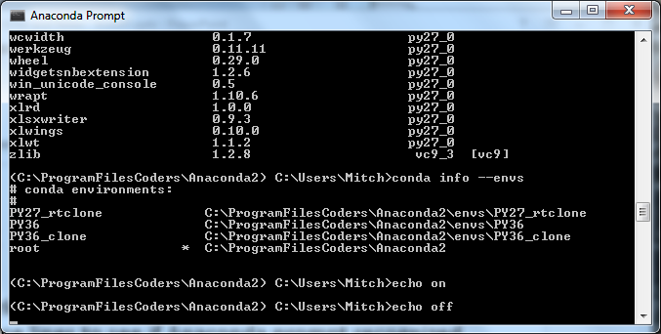
Command test: echo – issue in Anaconda?
Echo on / echo off works in batch scripts to tell it whether to output to console. Tested these lines to see if Anaconda prompt recognized the commands and the prompt hung up

Slide 44
Batch file issue (and what to do about it)
Created a simple batch file for Anaconda that runs the list command on all environments and outputs the results to a file.
Launching Anaconda prompt from an icon – the script halts every time just a few lines only running my initial command to write the environment list to a file, but then not continuing to the commands that would list the packages in all of my 6 or so environments
Solution: launch Anaconda Prompt using “run as administrator” and then try it and it seems to work then.
But … on running script a second time or trying another script, problem recurs
Solution: load a new Anaconda Prompt (using “run as administrator”) and run the script that failed and it now works
Conclusion: to ensure script works, it needs to be first thing launched in an Anaconda Prompt that was open with “run as administrator” when working on Windows 7 64 bit
Above symptom is intermittent: had some cases where it worked fine and others where it had to be the first script run in an Anaconda Prompt loaded as administrator to work.

Slide 45
Appendix
Preserved a few images for me along the way
These are not needed from a standpoint of indicating issues encountered or what to do about them
A few have useful info in more detail about a symptom or two mentioned earlier

Slide 46
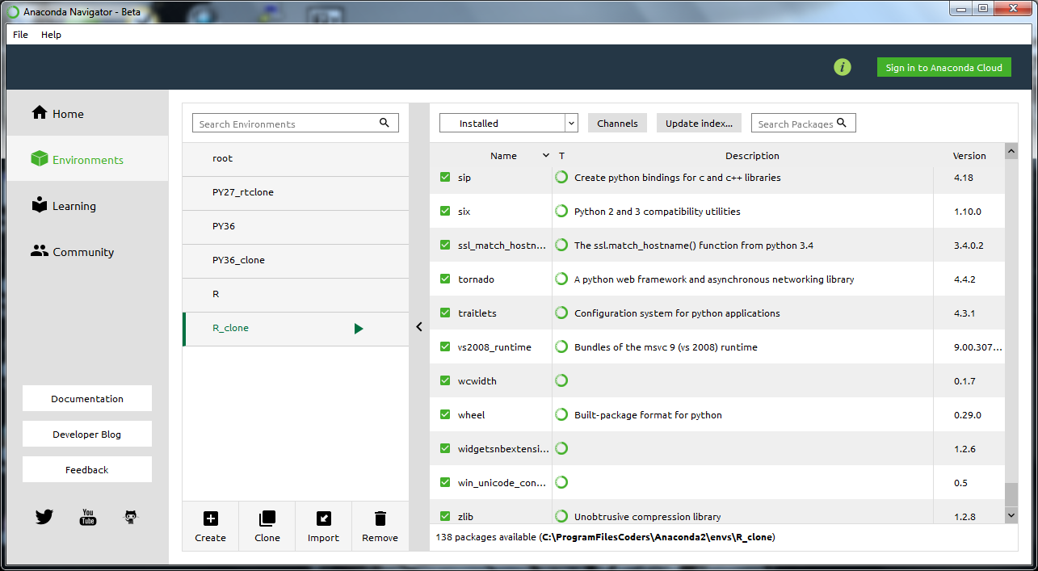
Finished working env on Navigator At this stage – envs had default installation screenshot taken “just in case”, test PY not built yet

Slide 47
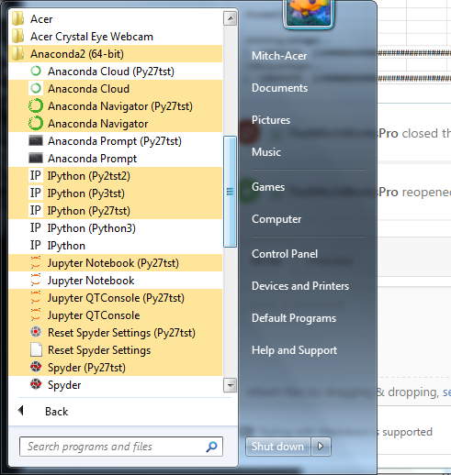
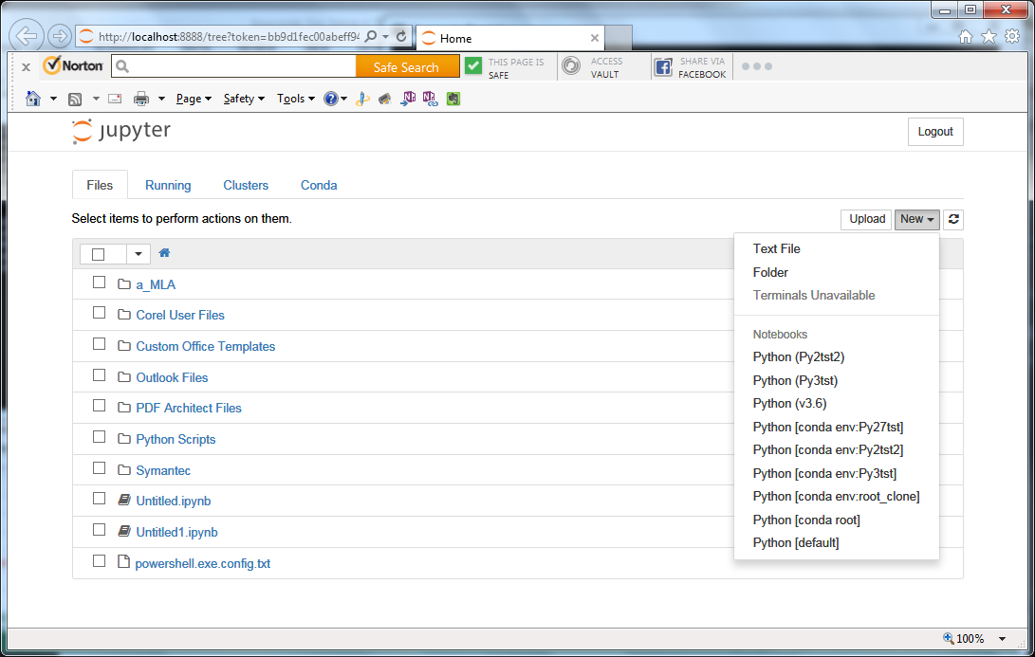
Earlier installation: tested behaviors of different ways of adding env before de-installation (env had corrupted beautiful soup in it anyway); Note the icon duplication problem shown on the left

Slide 48
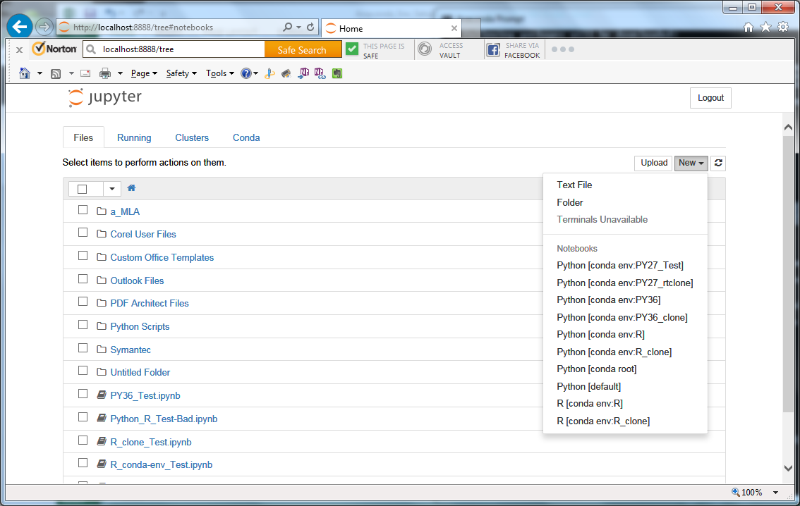
Mostly finished working environment
Has Python 2.7 default, test 2.7, clone of 2.7, 3.6, clone of 3.6, R and R_clone environments
Extra menu items are an unintentional side effect of Anaconda (and Jupyter console window shows 10 kernels active for these 7 enviroments

